Slide 1
Technology internship at Comerica bank
Griff Prime

Slide 2


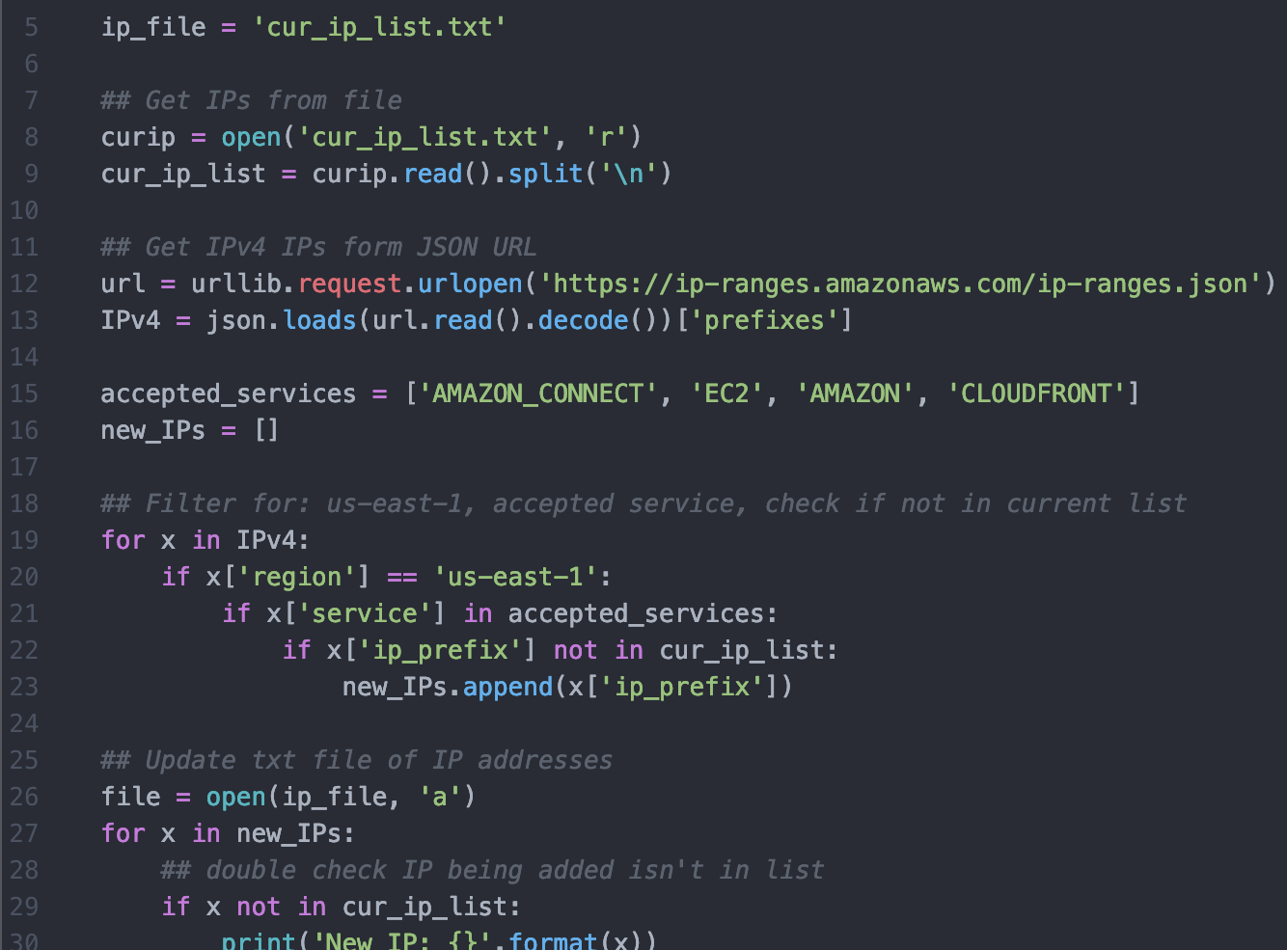
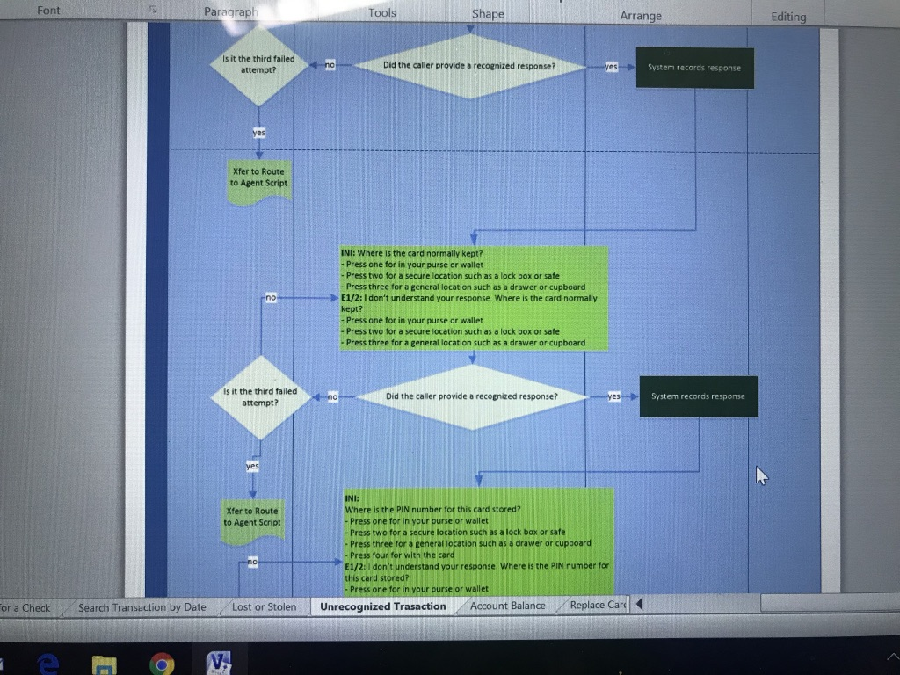
What I Did
Work with AWS to create prototypes for team to implement in future
Automatically transferring files between S3 buckets
Performing sentiment analysis on call center audio recordings
Participate (and rank) in automation hackathon with other interns
Create flow charts to document code used by virtual receptionist

Slide 3
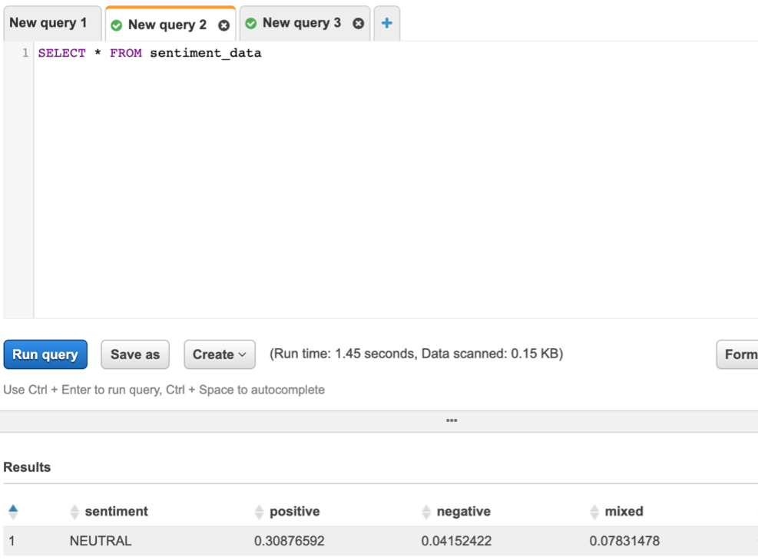
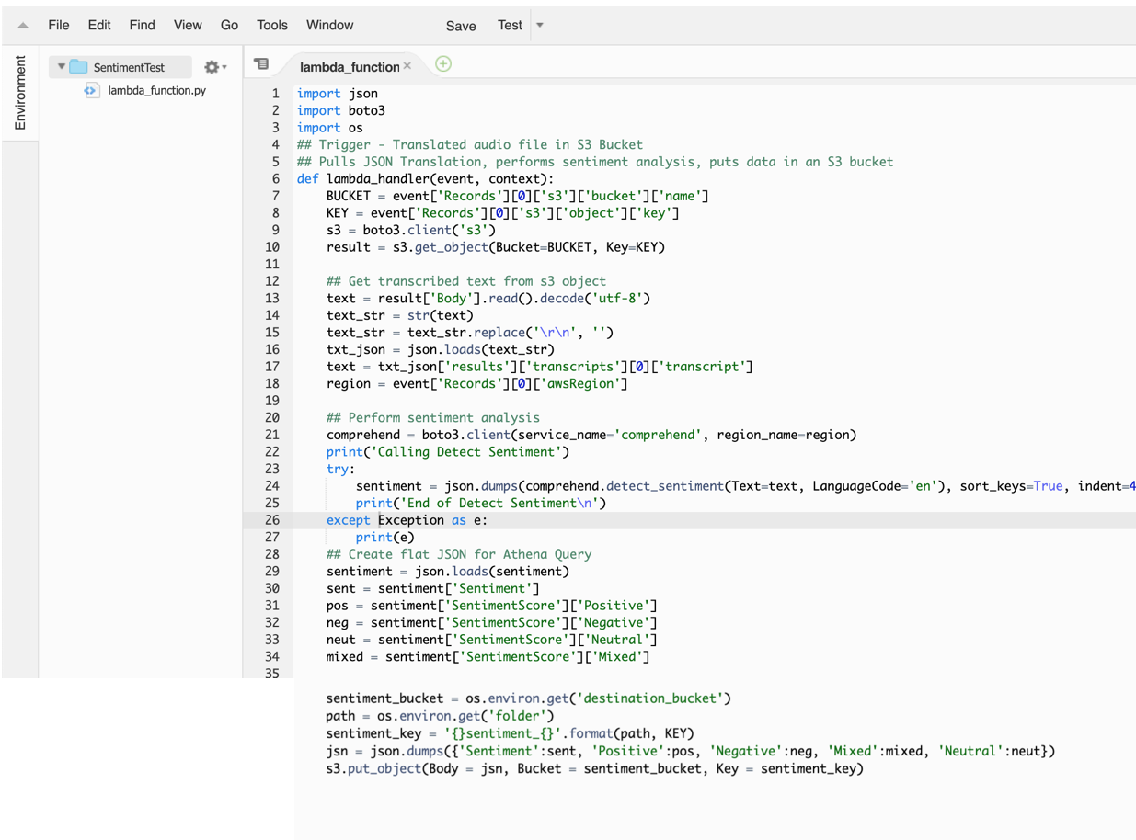
What I learned
Different AWS environments and how they are able to interact with each other to perform various tasks
How to better interact with co-workers upper management in large corporations
How to conduct informational interviews and make lasting relationships with co-workers

Slide 4
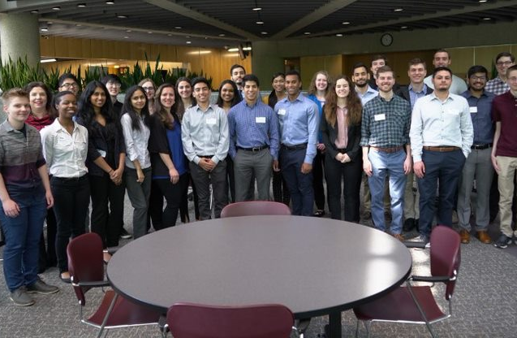
Skills/Trends I've seen
How to run meetings (in person or over Skype)
Prioritizing work by immediate importance
Increased interest in using technology to help achieve business objectives
Stronger focus on educating employees about the importance of UX research/design

Slide 5
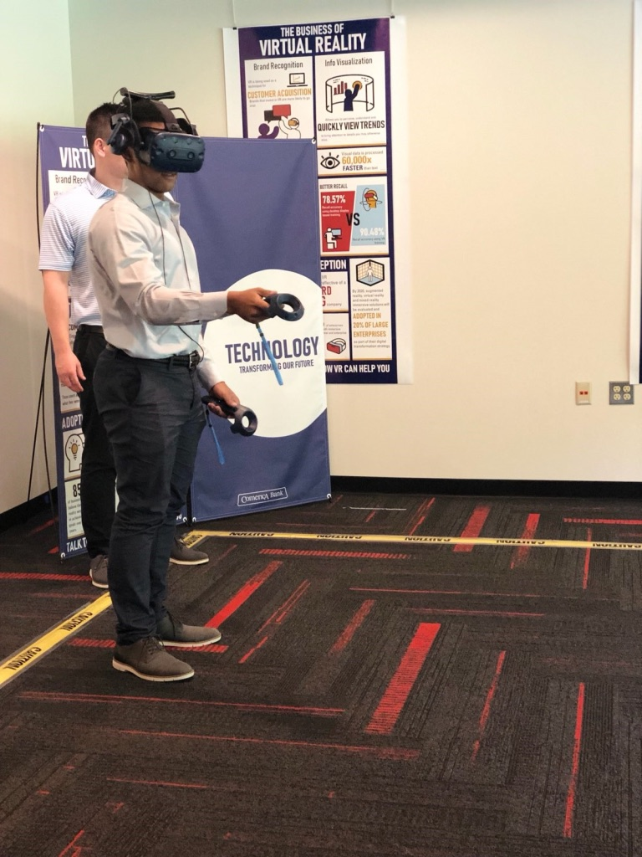
Impact on future career
Experiences helped me determine what specific job roles and titles I will pursue in the future
Helped me understand locations I may want to apply to in future
Made connections that I may be able to leverage as I advance in my career

